Slide 1
Developing intelligent robots with AWS RoboMaker
Code / Contribute / Collaborate / Commit
Thomas Moulard tmoulard@amazon.com
06/16/2019
Notes:
Easily develop, test, and deploy intelligent robotics applications

Slide 2
Table of contents
Why AWS RoboMaker?
Accelerating Robot Validation
Simplifying Robot Development
Fleet Management
Notes:
Talk about AWS RoboMaker and its main features (dev / simulation / fleet management)
Those features integrate and extend open-source software

Slide 3
Why AWS RoboMaker?

Slide 4
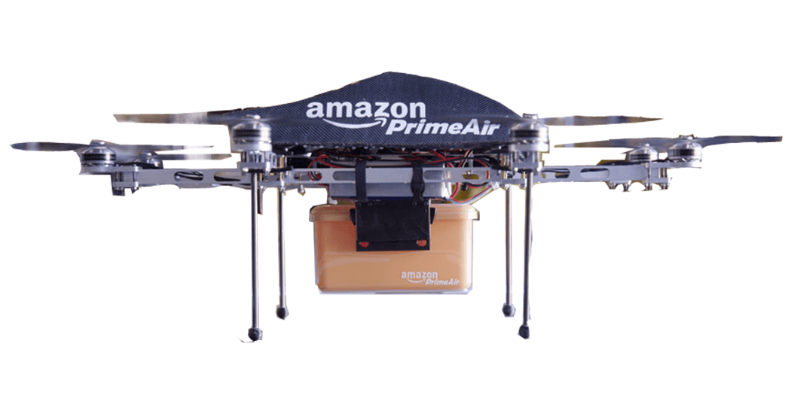
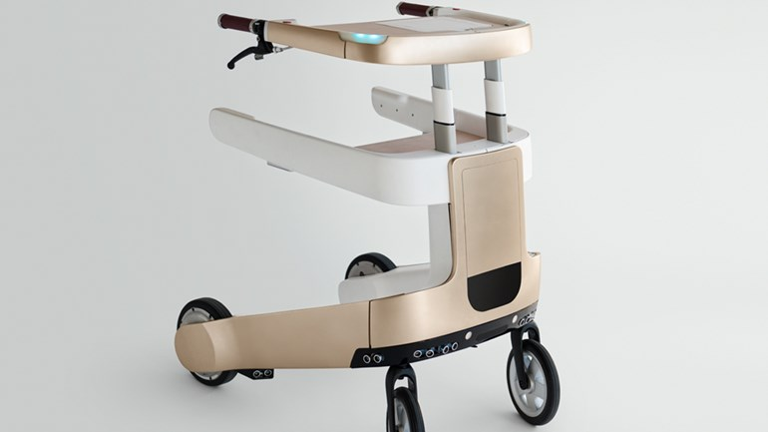
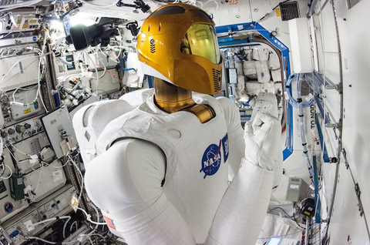
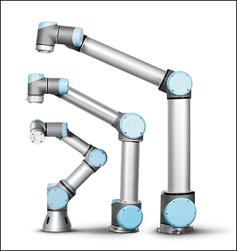
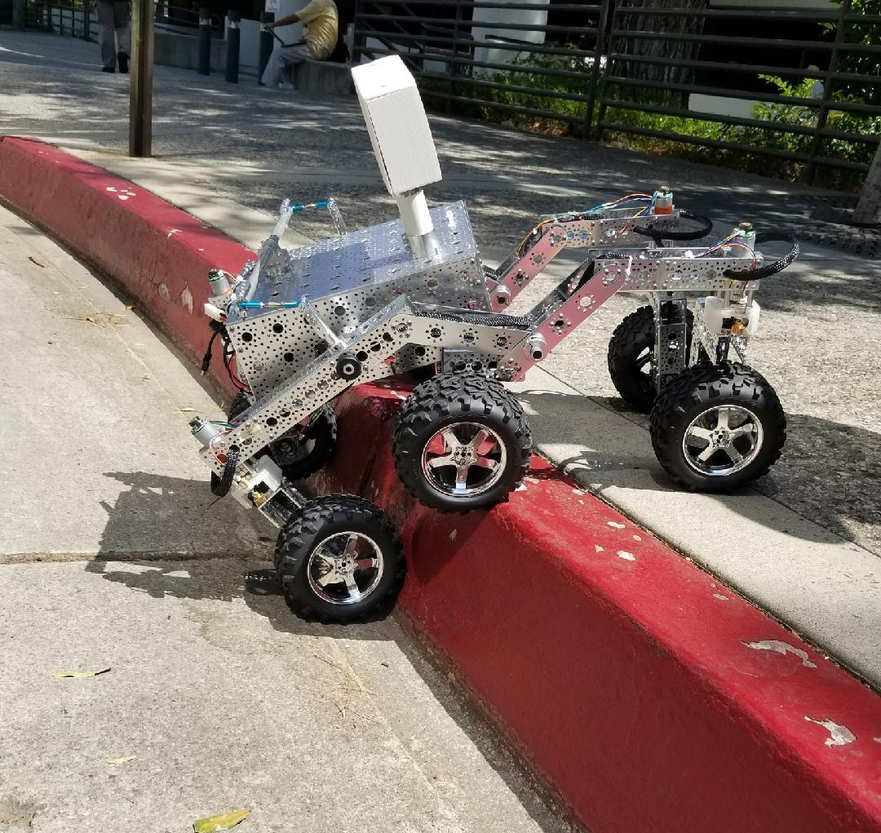
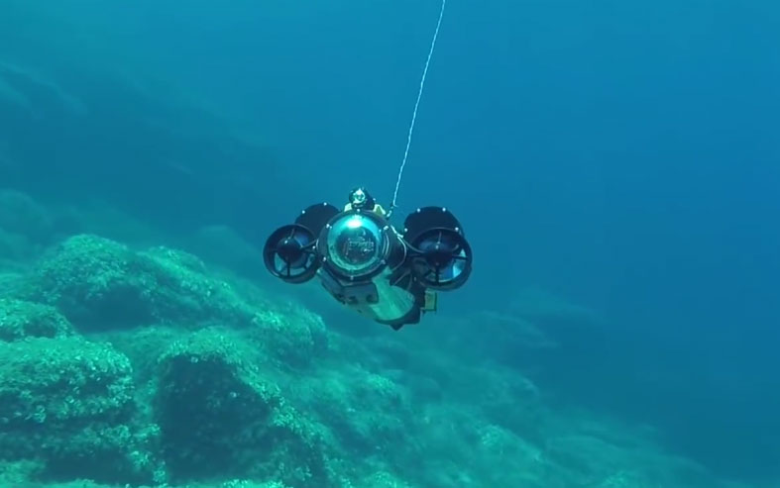
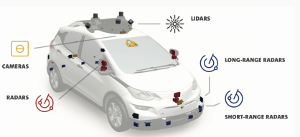
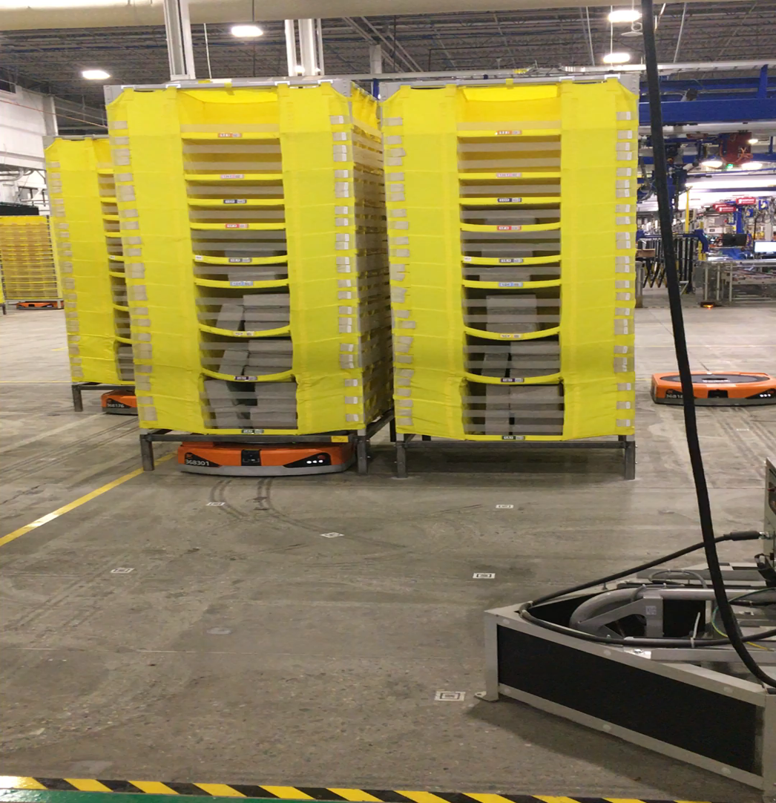
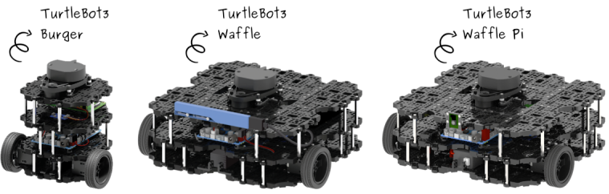
Robot landscape
Drones
Autonomous Walker
International Space Station
Robotic Arms
Self-Driving Vehicles
Water
Education
Rover
Logistics
Notes:
Robots come in many shapes
But they share common points: they all need logging, security, software deployment, fundamental algorithms for navigation, perception, etc.
Lots of companies start from scratch – what if this could be avoided?

Slide 5


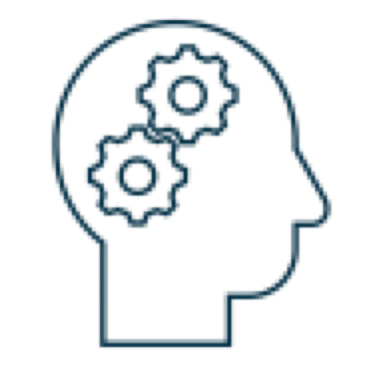
Building Software for Robots
Perceive
Plan
Act
…and repeat
Notes:
Perceive using sensors, determine the next action using software and realize this action.
Loop closure done by the ”real world”
Orange box is software, rest is not. Hardware is a crucial part of a robotic platform

Slide 6
Building Software for Robots
Perceive
Plan
Act
Localization
Driver
Motion Gen.
Driver
Navigation
…and repeat
Notes:
Algorithms are organized in components, usually different processes.
Advantages are the same than for micro-services, separation of concern, better resilience to failures or crashes.
Require a message passing system. Pub/sub is a popular approach.

Slide 7
Accelerating Robot Validation

Slide 8


Challenge: Validation is hard
Errors are critical: a single bug can break a robot.
Software input is uncontrolled.
Experimenting with hardware is slow.
Software is tightly coupled to hardware.
System behavior depends on a large number of parameters which need to be tuned.
Finding bugs in a robotic system is time consuming and bugs have a high impact.
…
One robot serves a few users, deploying software is hard.
(Any) Server
One server serves a lots of users, deploying software is easier.

Slide 9

Solution: Re-using Software!
ROS provides:
Message passing between components
Developer productivity tools: message recording and visualization.
Ecosystem of robotics components for motor control, motion planning, etc.
BSD license
Supports C++, Python and other languages.
New generation of ROS, ROS 2 brings advanced middleware features.
Localization
Driver
Motion Gen.
Driver
Navigation

Slide 10
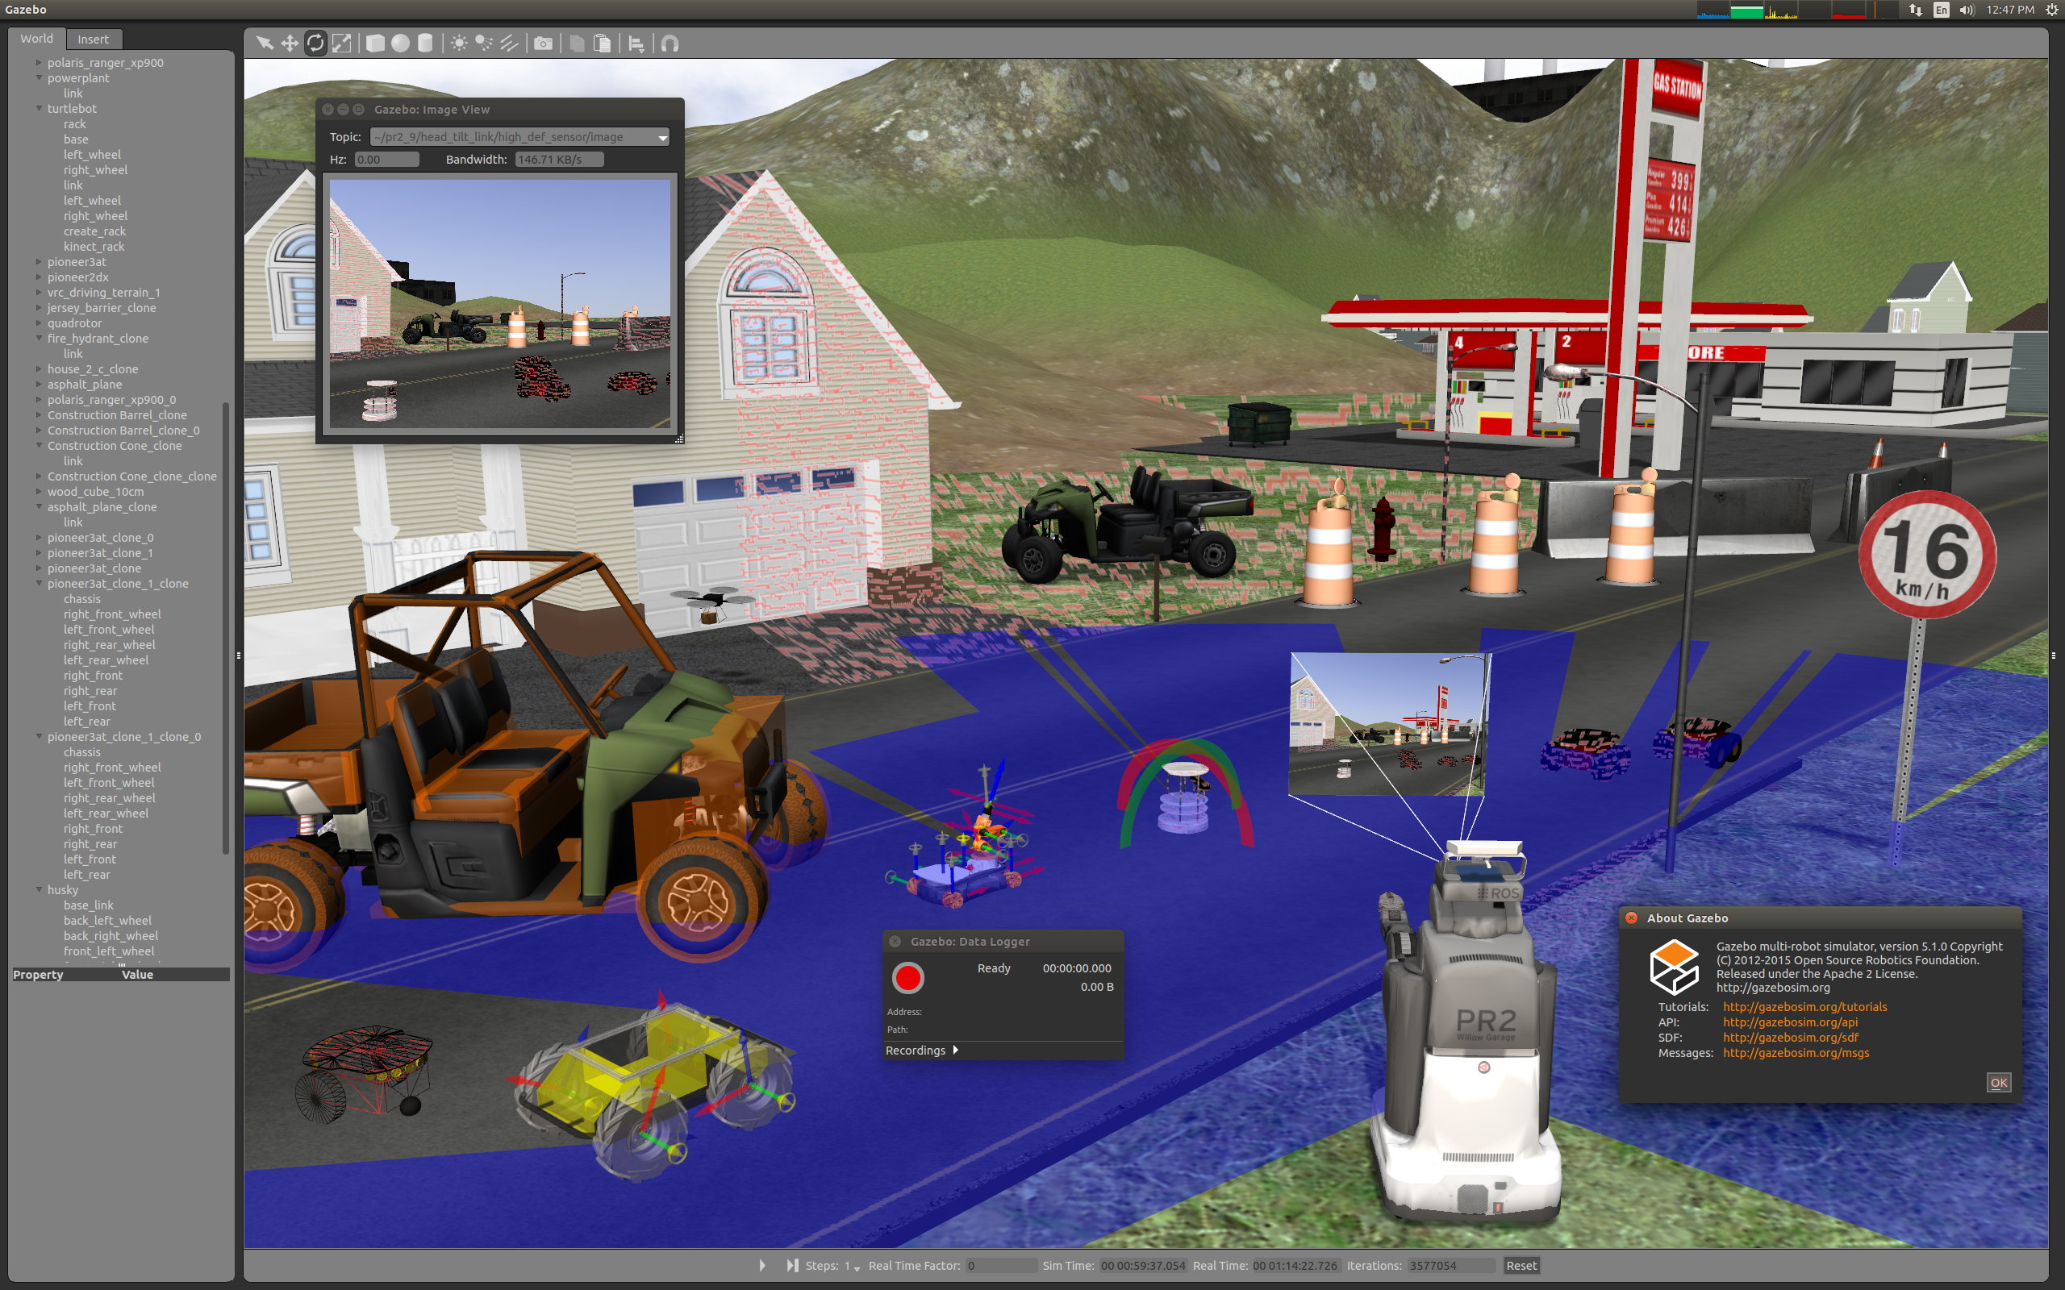

Solution: Simulation
Gazebo…
Simulates sensors and their imperfections
Simulates world physics
Seamlessly integrates with ROS.
Apache 2.0 license
System Under Test
Localization
Driver
Motion Gen.
Driver
Navigation

Slide 11
AWS RoboMaker
Simulation
Pre-built virtual 3D worlds provided out of box, or bring your own
Zero infrastructure to provision, configure or manage
Run multiple simulations in parallel
Auto-scale based on simulation complexity
Pay-as-you-go simulation resource consumption

Slide 12
Simplifying Development

Slide 13
Challenge: Robots are (too) complex!
Fundamental Algorithms
Hardware Interface
Operating System
App
Platform API
From a software perspective, building a robot means…
Choosing a platform
Interfacing with hardware
Implementing complex algorithms
Defining the architecture allowing all components to operate together.
…under strong constraints of performance, latency and safety…
…to make it a product, we need to care about:
business logic, battery consumption, user privacy, cyber-security, fleet operations…
Robotics companies software stack is too deep.
Robotics is multi-disciplinary but roboticists cannot be experts on everything.
Very capital intensive!
Roboticists own the device end-to-end
Fundamental Algorithms
Hardware Interface
Operating System
App
Platform API
Cloud and Smartphone Platforms let developers focus on their application.

Slide 14
Solution: Open-Source Software and Industrial Collaboration
We are contributing to ROS 2!
Features
New Quality of Service Settings
Logging System Improvements
Portability
ARM HF Support
Code Quality
Improved QA to detect memory and concurrency bugs
Security
Secure ROS (SROS) Improvements
ROS 2 Threat Model
ROS 2 Technical Steering Committee Members:
Acutronic Robotics
Amazon
Apex.AI
ARM
Bosch
eProsima
GVSC (TARDEC)
Intel
LGE
Microsoft
Open Robotics
ROBOTIS
Tier IV
Toyota Research Institute

Slide 15
AWS RoboMaker
Development Environment
Start application development with zero setup effort
Create a RoboMaker development environment with a single click of a button
Includes pre-installed RoboMaker cloud extensions and sample robotics applications
Automatic download, compile and configuration of operating system, development software, and ROS

Slide 16
AWS RoboMaker
Cloud Extensions
Integrates ROS with Amazon Lex, Amazon Polly, Amazon Kinesis Video Streams, Amazon Rekognition, and Amazon CloudWatch.
Extend robot capabilities easily and without requiring additional on-board computations.
Seamlessly stream robot metrics and logs to Amazon CloudWatch

Slide 17
Fleet Management

Slide 18
AWS RoboMaker
Fleet Management
Integrated with AWS IoT Greengrass
Built-in robot registry, security, and fault-tolerance
Deploy robotics application over-the-air with just a few clicks on the AWS Management Console

Slide 19
AWS RoboMaker Architecture

Slide 20
AWS RoboMaker Architecture
Lex
Polly
Rekognition
Kinesis Video Streams
CloudWatch Metrics
CloudWatch Logs
Build Tool
Cloud Development Environment
Debug
ML Model Training
Iterative
Simulation
Regression
Testing
Metric and Logging
Registration
Deployment
Monitoring
Management
Cloud Extensions
for ROS
Development
Environment
Simulation
Fleet
Management
ROS/ROS2

Slide 21
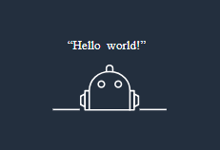
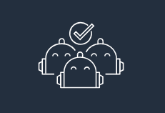
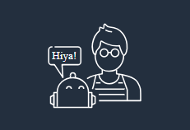
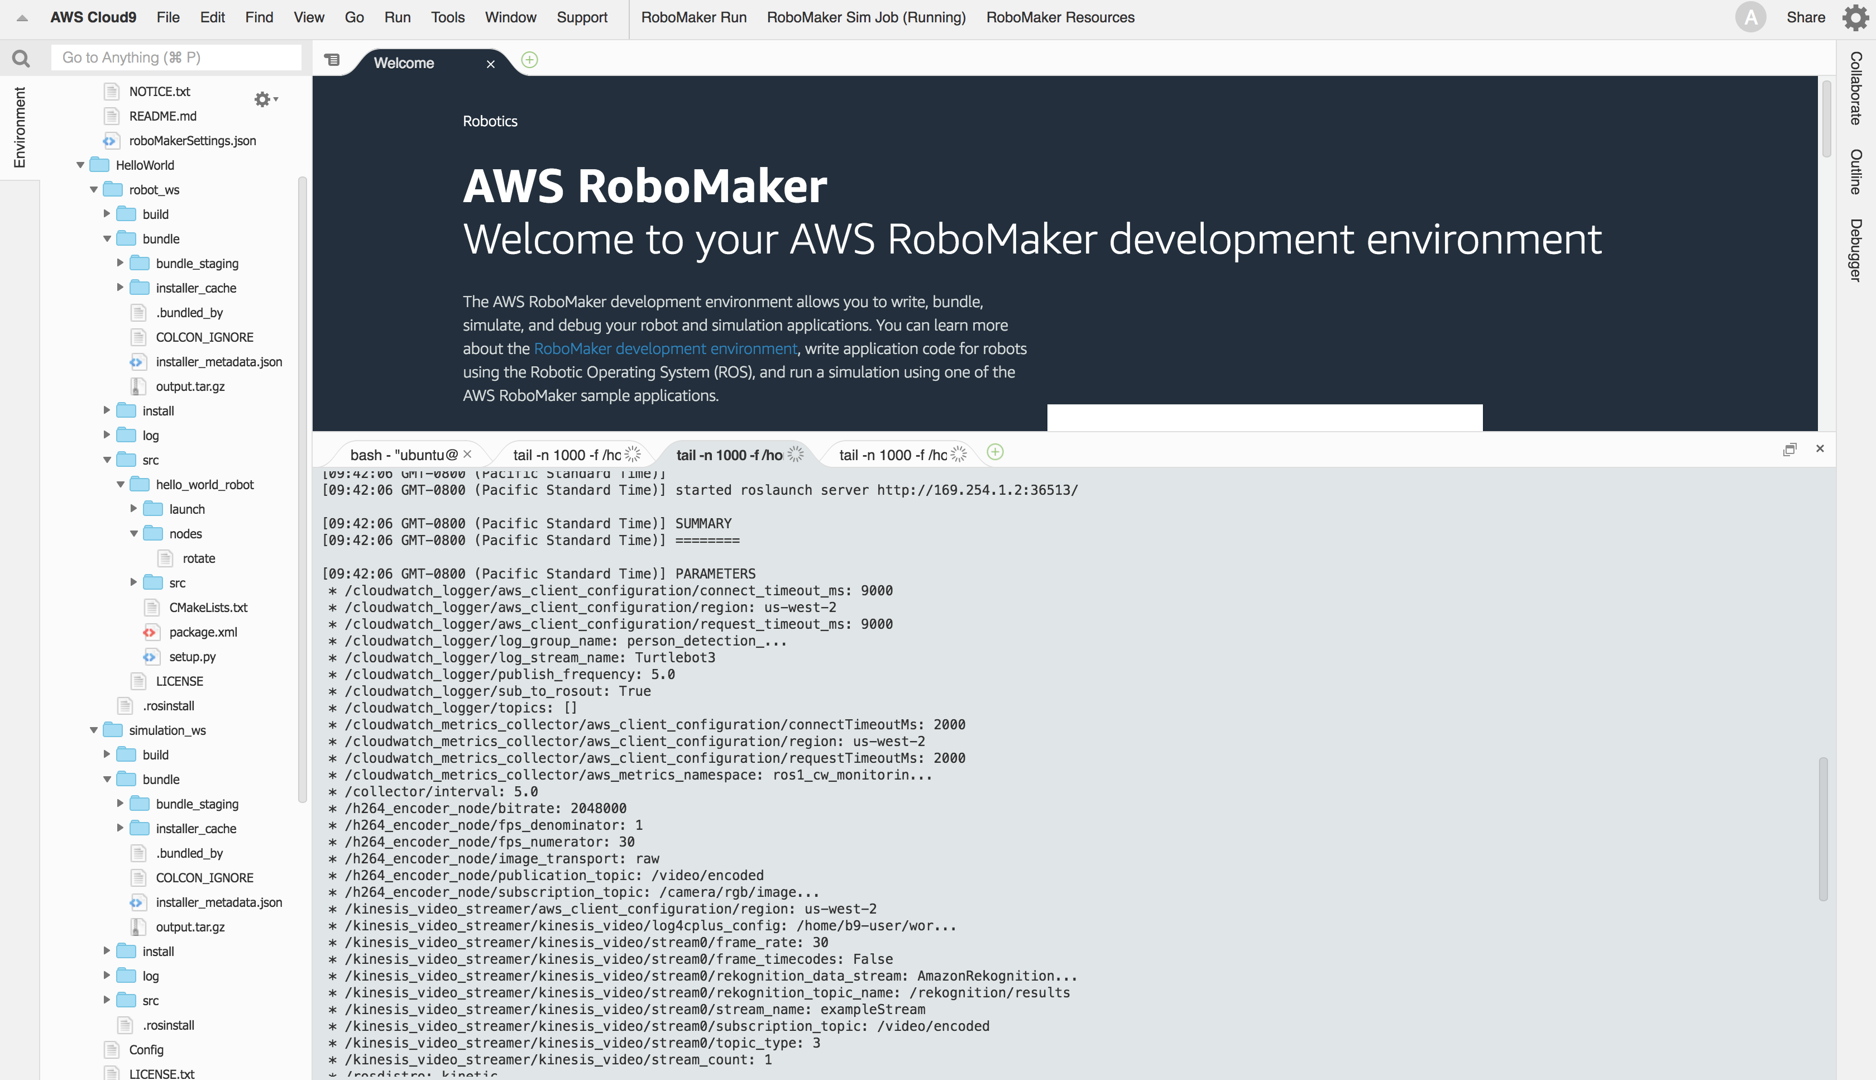
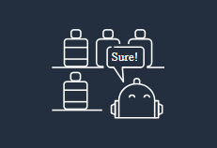
Try AWS RoboMaker today!
Sample Applications
AWS Cloud9 simplify ROS development
Cloud Simulation accelerate robot validation
Fleet Management provide over the air update capabilities to a robotic fleet.
Cloud Extensions easily interface ROS with AWS services such as Amazon Lex, Amazon Polly, Amazon Kinesis Video Streams, Amazon Rekognition, and Amazon CloudWatch.
aws.amazon.com/robomaker
Hello world
Robot monitoring
Navigation and person recognition
Voice commands

Slide 22
Thank you!

